Slide 1
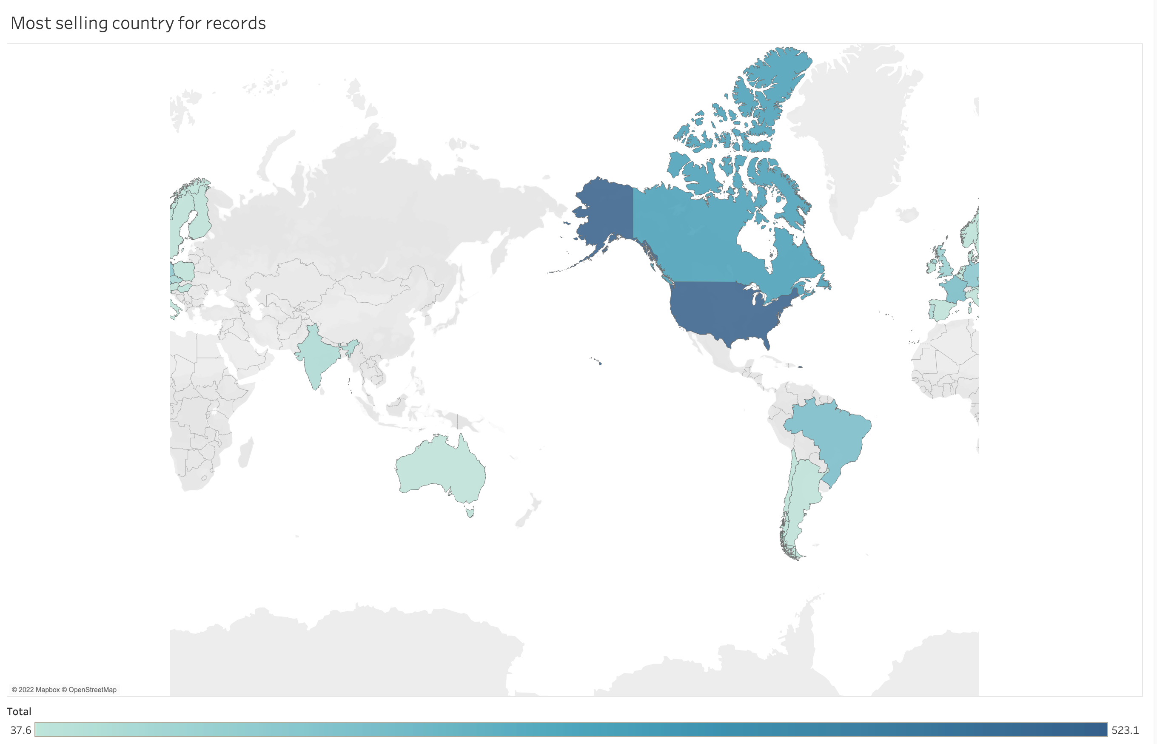
When we look at the map below that shows the countries that sell the most records, we notice that the United States and Canada have high rates compared to others.
So we recommend focusing on the US and Canada.

Slide 2
The type that people buy the most is the MPEG audio file, with a percentage of 88% compared to the rest of the types!
Therefore, we recommend focusing on an MPEG audio file and providing limited copies of the rest of the types

Slide 3
The Rock is the most popular genre was sold it has almost 37% of sales.
to maximize the benefit we suggest to provide all the rock songs.

Slide 4
We notice that Steve has a problem with sales compared to the rest, with a difference of 14 products more than double the number between Margaret and Jane, which is only 6!
We recommend that you follow up with Steve, understand the reason for his lack of sales, and address the problem

